Slide 1
Getting started with HPC
Introduction to nimbus (short version of training by HPC team)
Next steps
Demo: running code on nimbus
Student presentations
Kamran Arora: Firedrake
Chiara Boetti
Oliver Townsend

Slide 2

Introduction to nimbus
Slides provided by Research Computing Team; Digital, Data and Technology

Slide 3
Overview of high performance computing (HPC)

Slide 4
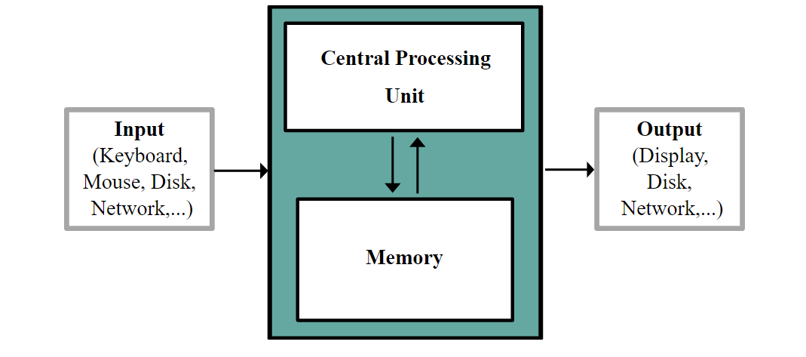
PC vs. HPC
Your PC is your local computing resource, good for small computational tasks. It is flexible, easy to set-up and configure for new tasks, though it has limited computational resources.

Slide 5
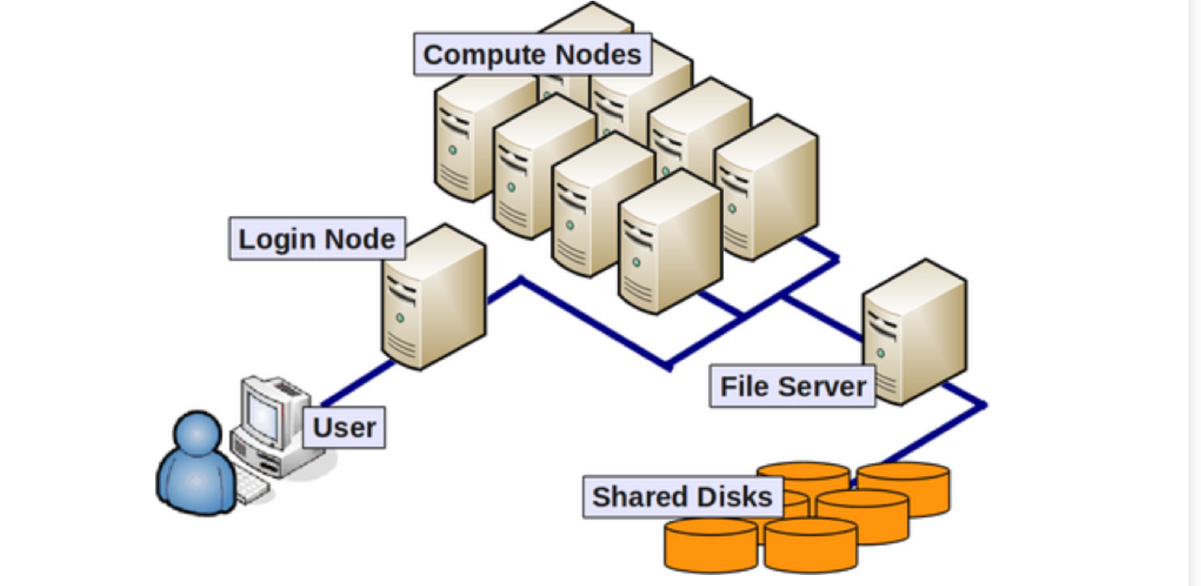
What is HPC?
A HPC system is typically described as a cluster, as it is made up from a cluster of computers, or compute nodes.
Each individual compute node is typically a lot more powerful than any PC with more memory, and more, faster CPU cores.

Slide 6

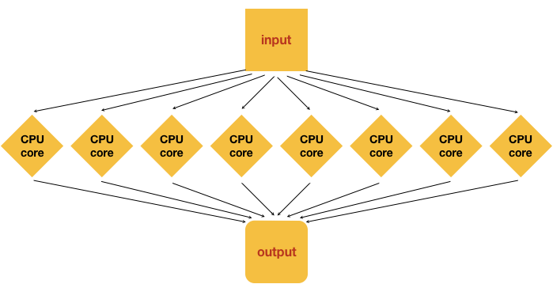
Parallelisation
Processing 1 input file to generate 1 output
On a personal computer this would happen on a single core in the CPU
On a cluster we have access to many cores on a single node, so we can split the analysis of a single file into multiple distinct processes and use many cores to speed up the generation of an output. This is called multithreading.

Slide 7
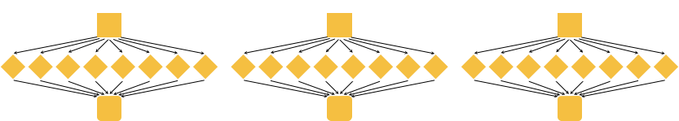
Parallelisation
If we had 3 input files
On a personal computer this would happen one after the next on a single core in the CPU
On a cluster we can make each input run on a separate core, so all 3 files run simultaneously, or better we can multithread each process and run them on a separate set of 8 cores. This is considered true parallelisation
Multithreaded and Parallel

Slide 8

What is Nimbus?
Bath’s Cloud Based Supercomputer
Hosted in Microsoft Azure Cloud
Regularly updated hardware
Scalable to meet computational needs
Large diversity of processors optimised for research needs
PAYG or significantly cheaper spot compute services
Bespoke Research Computing Account Management Portal
https://rcam.bath.ac.uk/
Cost Calculator
https://cost-calc.hpc.bath.ac.uk/calculation/64fb2b2a1b085be79aee7218
Open On Demand portal
https://ood.hpc.bath.ac.uk/

Slide 9
coMPUTE OPTIONS

Slide 10
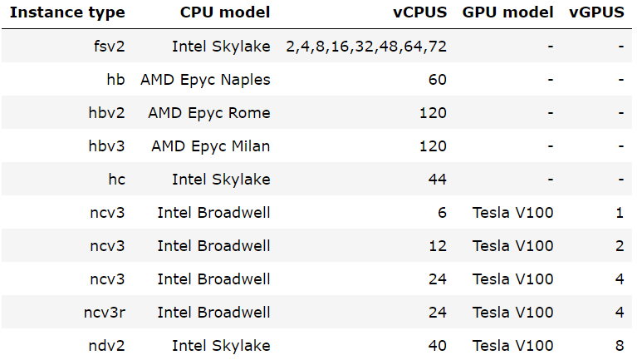
Compute Instances Available
The hb* instances are suggested for applications driven by memory bandwidth such as OpenFOAM and ANSYS.
The hc* & f* instances are suggested for applications driven by compute such as HPL and ORCA.
The n* partitions are for GPU accelerated workloads and visualization sessions.

Slide 11
Cost estimator
https://cost-calc.hpc.bath.ac.uk/
Details on compute instances
https://docs.microsoft.com/en-us/azure/virtual-machines/sizes

Slide 12
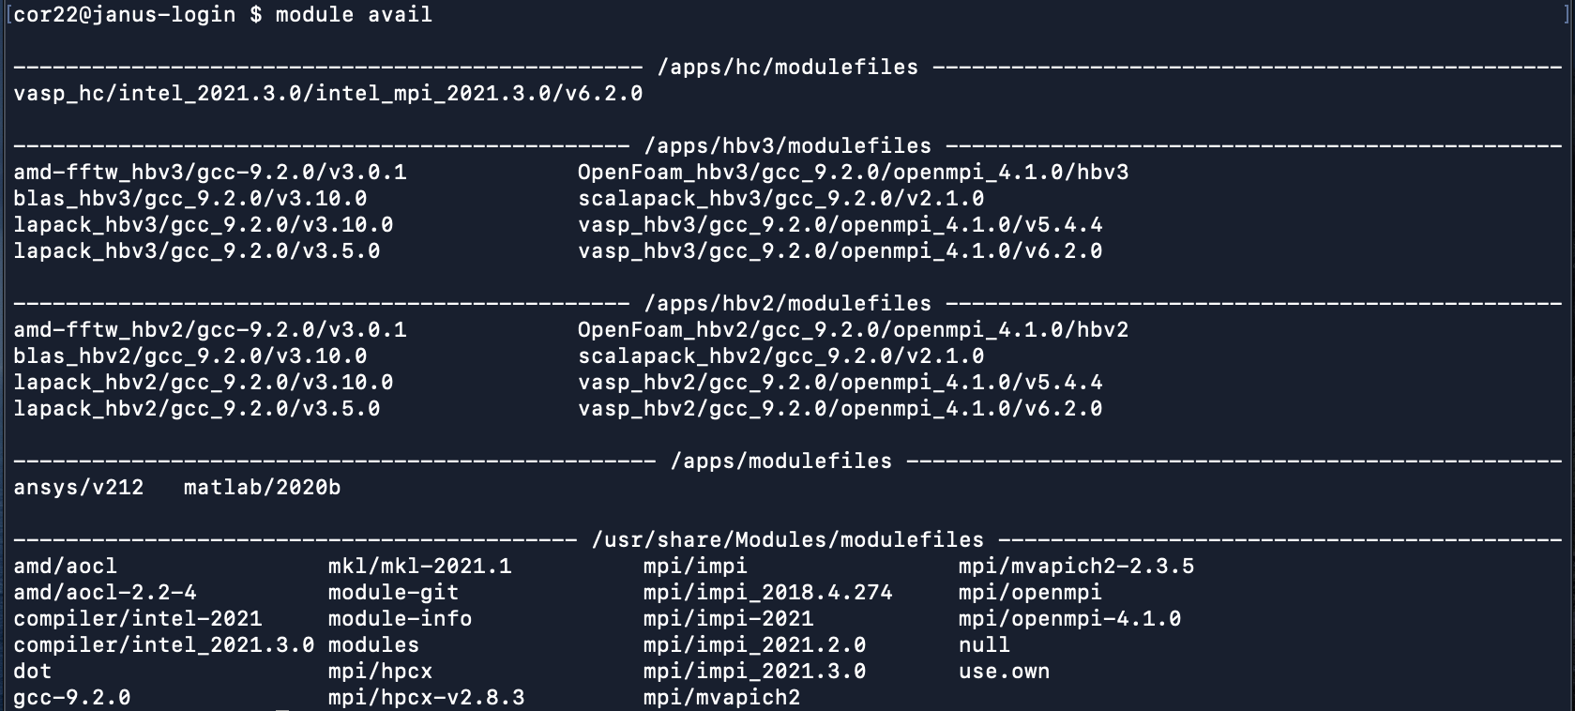
Software Available
On Nimbus, module is used to manage different libraries and pieces of software and ensure users can access the version of applications they want.
You can check which modules are loaded with module list
You can see what modules are available with module avail
You can check if the modules are available on specific instances with module check [instance_type] [module_name]
To load modules, include module load [module_name] in your slurm script

Slide 13
Accessing nimbus

Slide 14
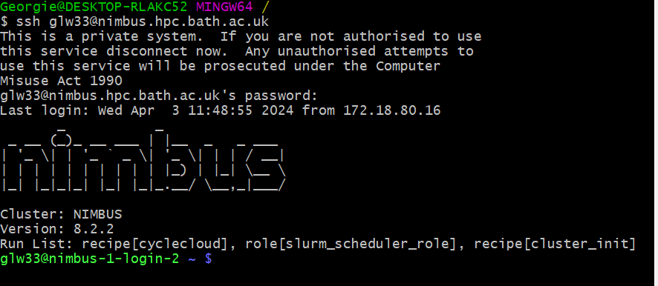
Nimbus HPC Shell Access
To access Nimbus through other terminals, you can log in using the ssh command:
ssh username@nimbus.hpc.bath.ac.uk

Slide 15
Nimbus File Systems
/shared/home/ : Each user has a home folder with 5GB storage which is backed up daily
/campaign/ : Each resource allocation has an associated campaign storage area with 50GB space. Campaign is where you keep files for current project work, not long-term archival storage
/apps/ : This space contains centrally compiled software for use of users
/u/ : The University H drive is mounted and can be accessed from login nodes
/mnt/resource/ : Some compute instances have fast local storage which can be accessed from the compute node
/burstbuffer/*/ : When running a job this space can be used to temporarily store required files, although the outputs must be copied back at the end of the run before the temporary folder is destroyed.
/x/ : The University X drive can be mounted and accessed here.

Slide 16
Submitting Jobs to the Cluster

Slide 17
SLURM
HPC systems use a scheduler to manage how jobs are run and resources are allocated.
If multiple jobs ran on a single node at the same time users would be competing for the same resources and jobs take longer.
The scheduler manages individual jobs which are allocated to the resources they need as they become available
This results in higher overall throughput and more consistent performance
SLURM : Simple Linux Utility for Resource Management is the scheduler used on Nimbus

Slide 18
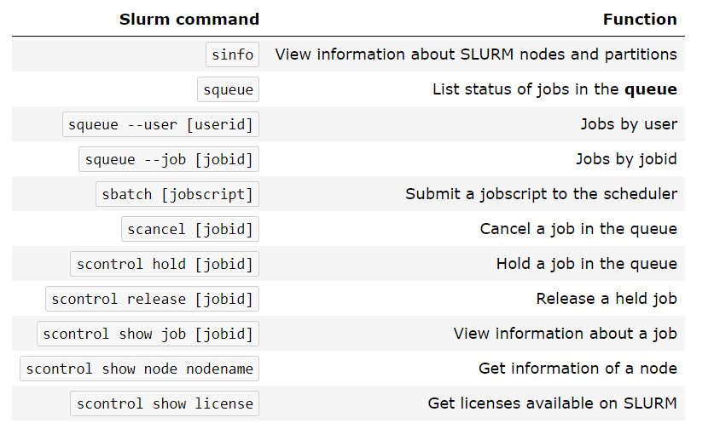
SLURM
Interacting with the scheduler is done through the shell using certain commands

Slide 19
SLURM script directives
#SBATCH –account= : tells slurm what account you wish to run against, this should be set you your resource allocation id
#SBATCH –job-name= : gives the job a name so you can identify it in the queue
#SBATCH –partition= : tells slurm which partition to put the job on
#SBATCH –qos= : tells slurm what Quality of Service you wish to run with, for Nimbus this will match the partition
#SBATCH—time= : tells slurm how long you wish to run the job for, can be: “minutes”, “minutes:seconds”, “hours:minutes:seconds”, “days-hours”, “days-hours:minutes” or “days-hours:minutes:seconds

Slide 20
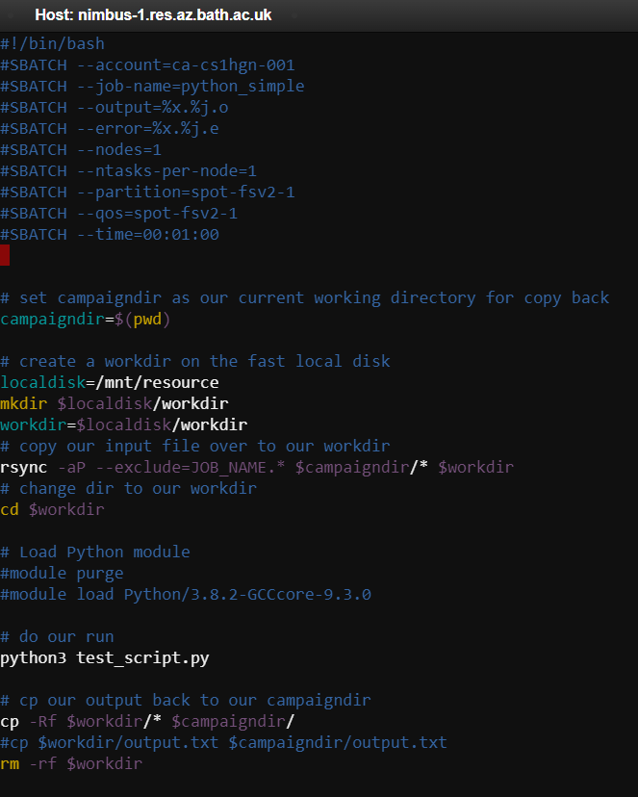
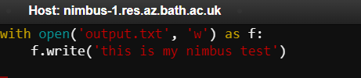
SLURM scripts
Our slurm script
Slurm directives detailed at the top
Instructions for copying data to the fast local disk
Running our python script
Copying our outputs back to campaign
Our python script

Slide 21
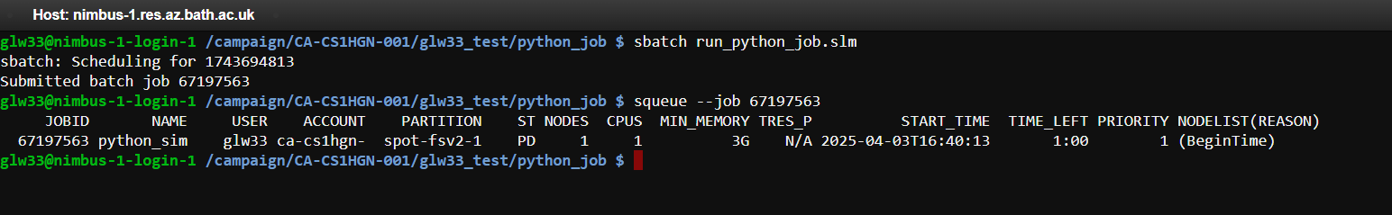

Submitting jobs to Nimbus
Jobs are submitted to Nimbus using sbatch <slurm_script.slm>
They generate a job id which can be used to check the status of the job in the queue with squeue –job <job_id>
The job can be cancelled using scancel <job_id>
Our outputs can be found in the /campaign/ directory upon completion

Slide 22
Overview of HPC Funding, Agresso and the RCAM Portal

Slide 23
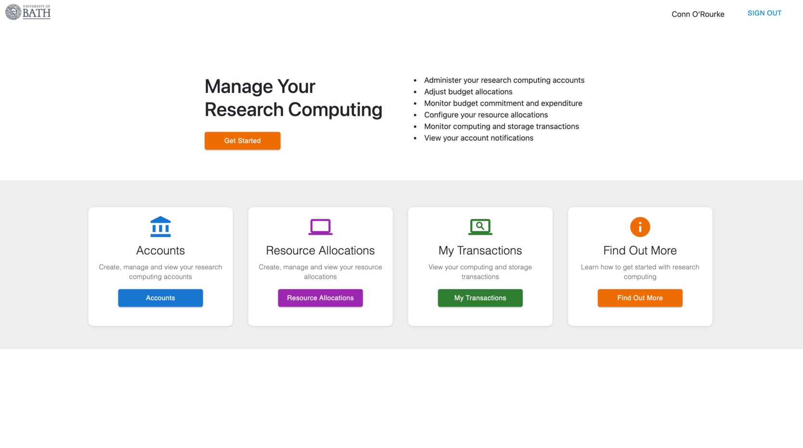
RCAM Portal
Funding for Nimbus is managed through the Research Compute Account Management Portal

Slide 24
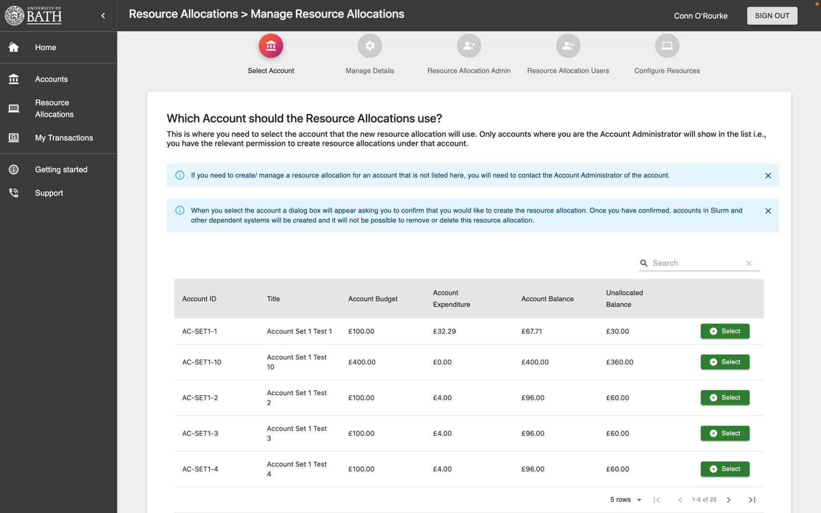
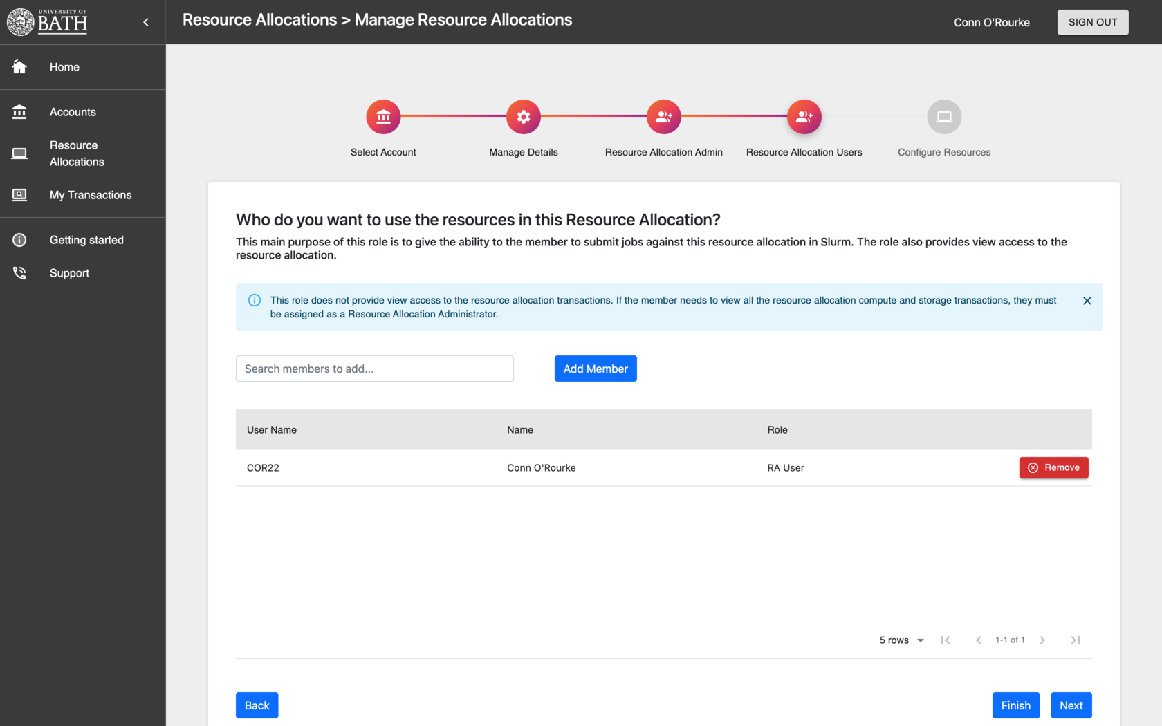
Resource Allocations

Slide 25
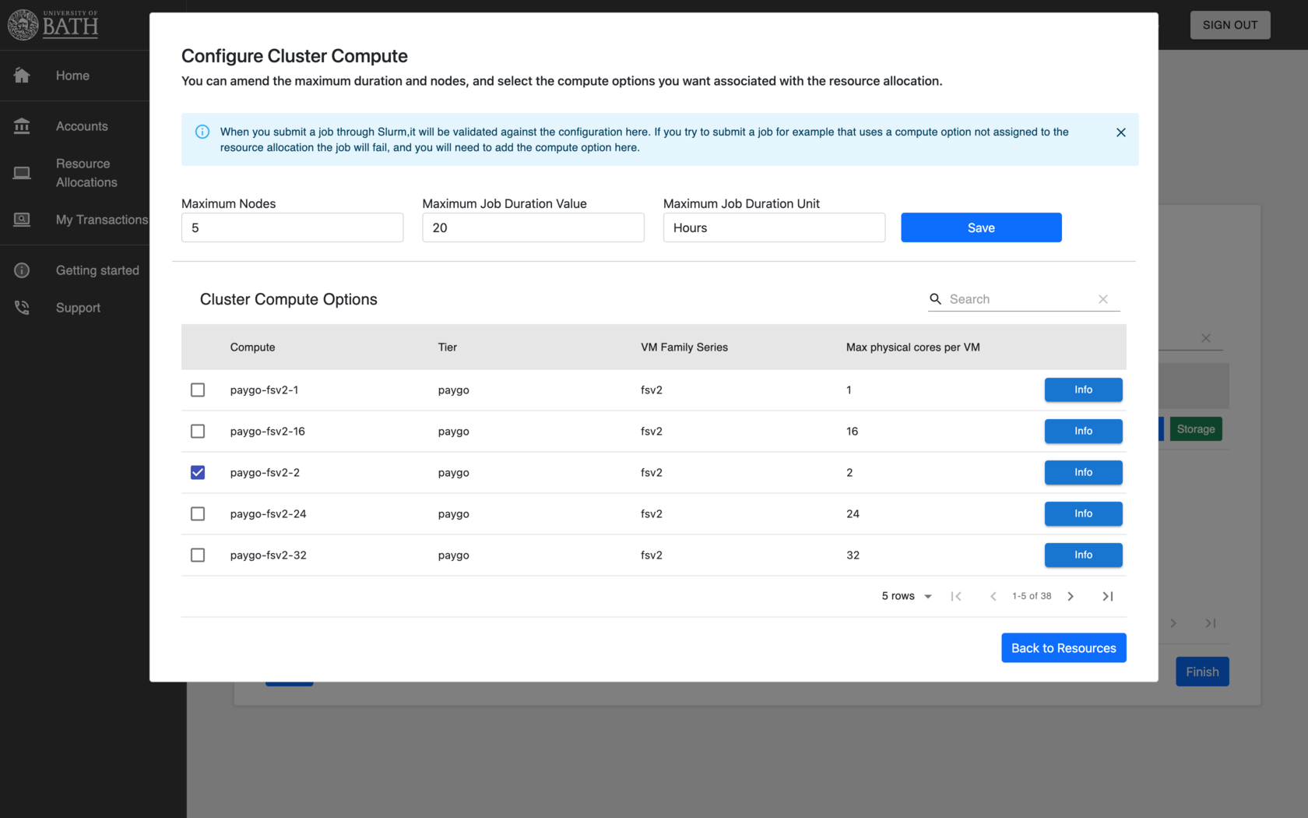
Resource Allocations

Slide 26
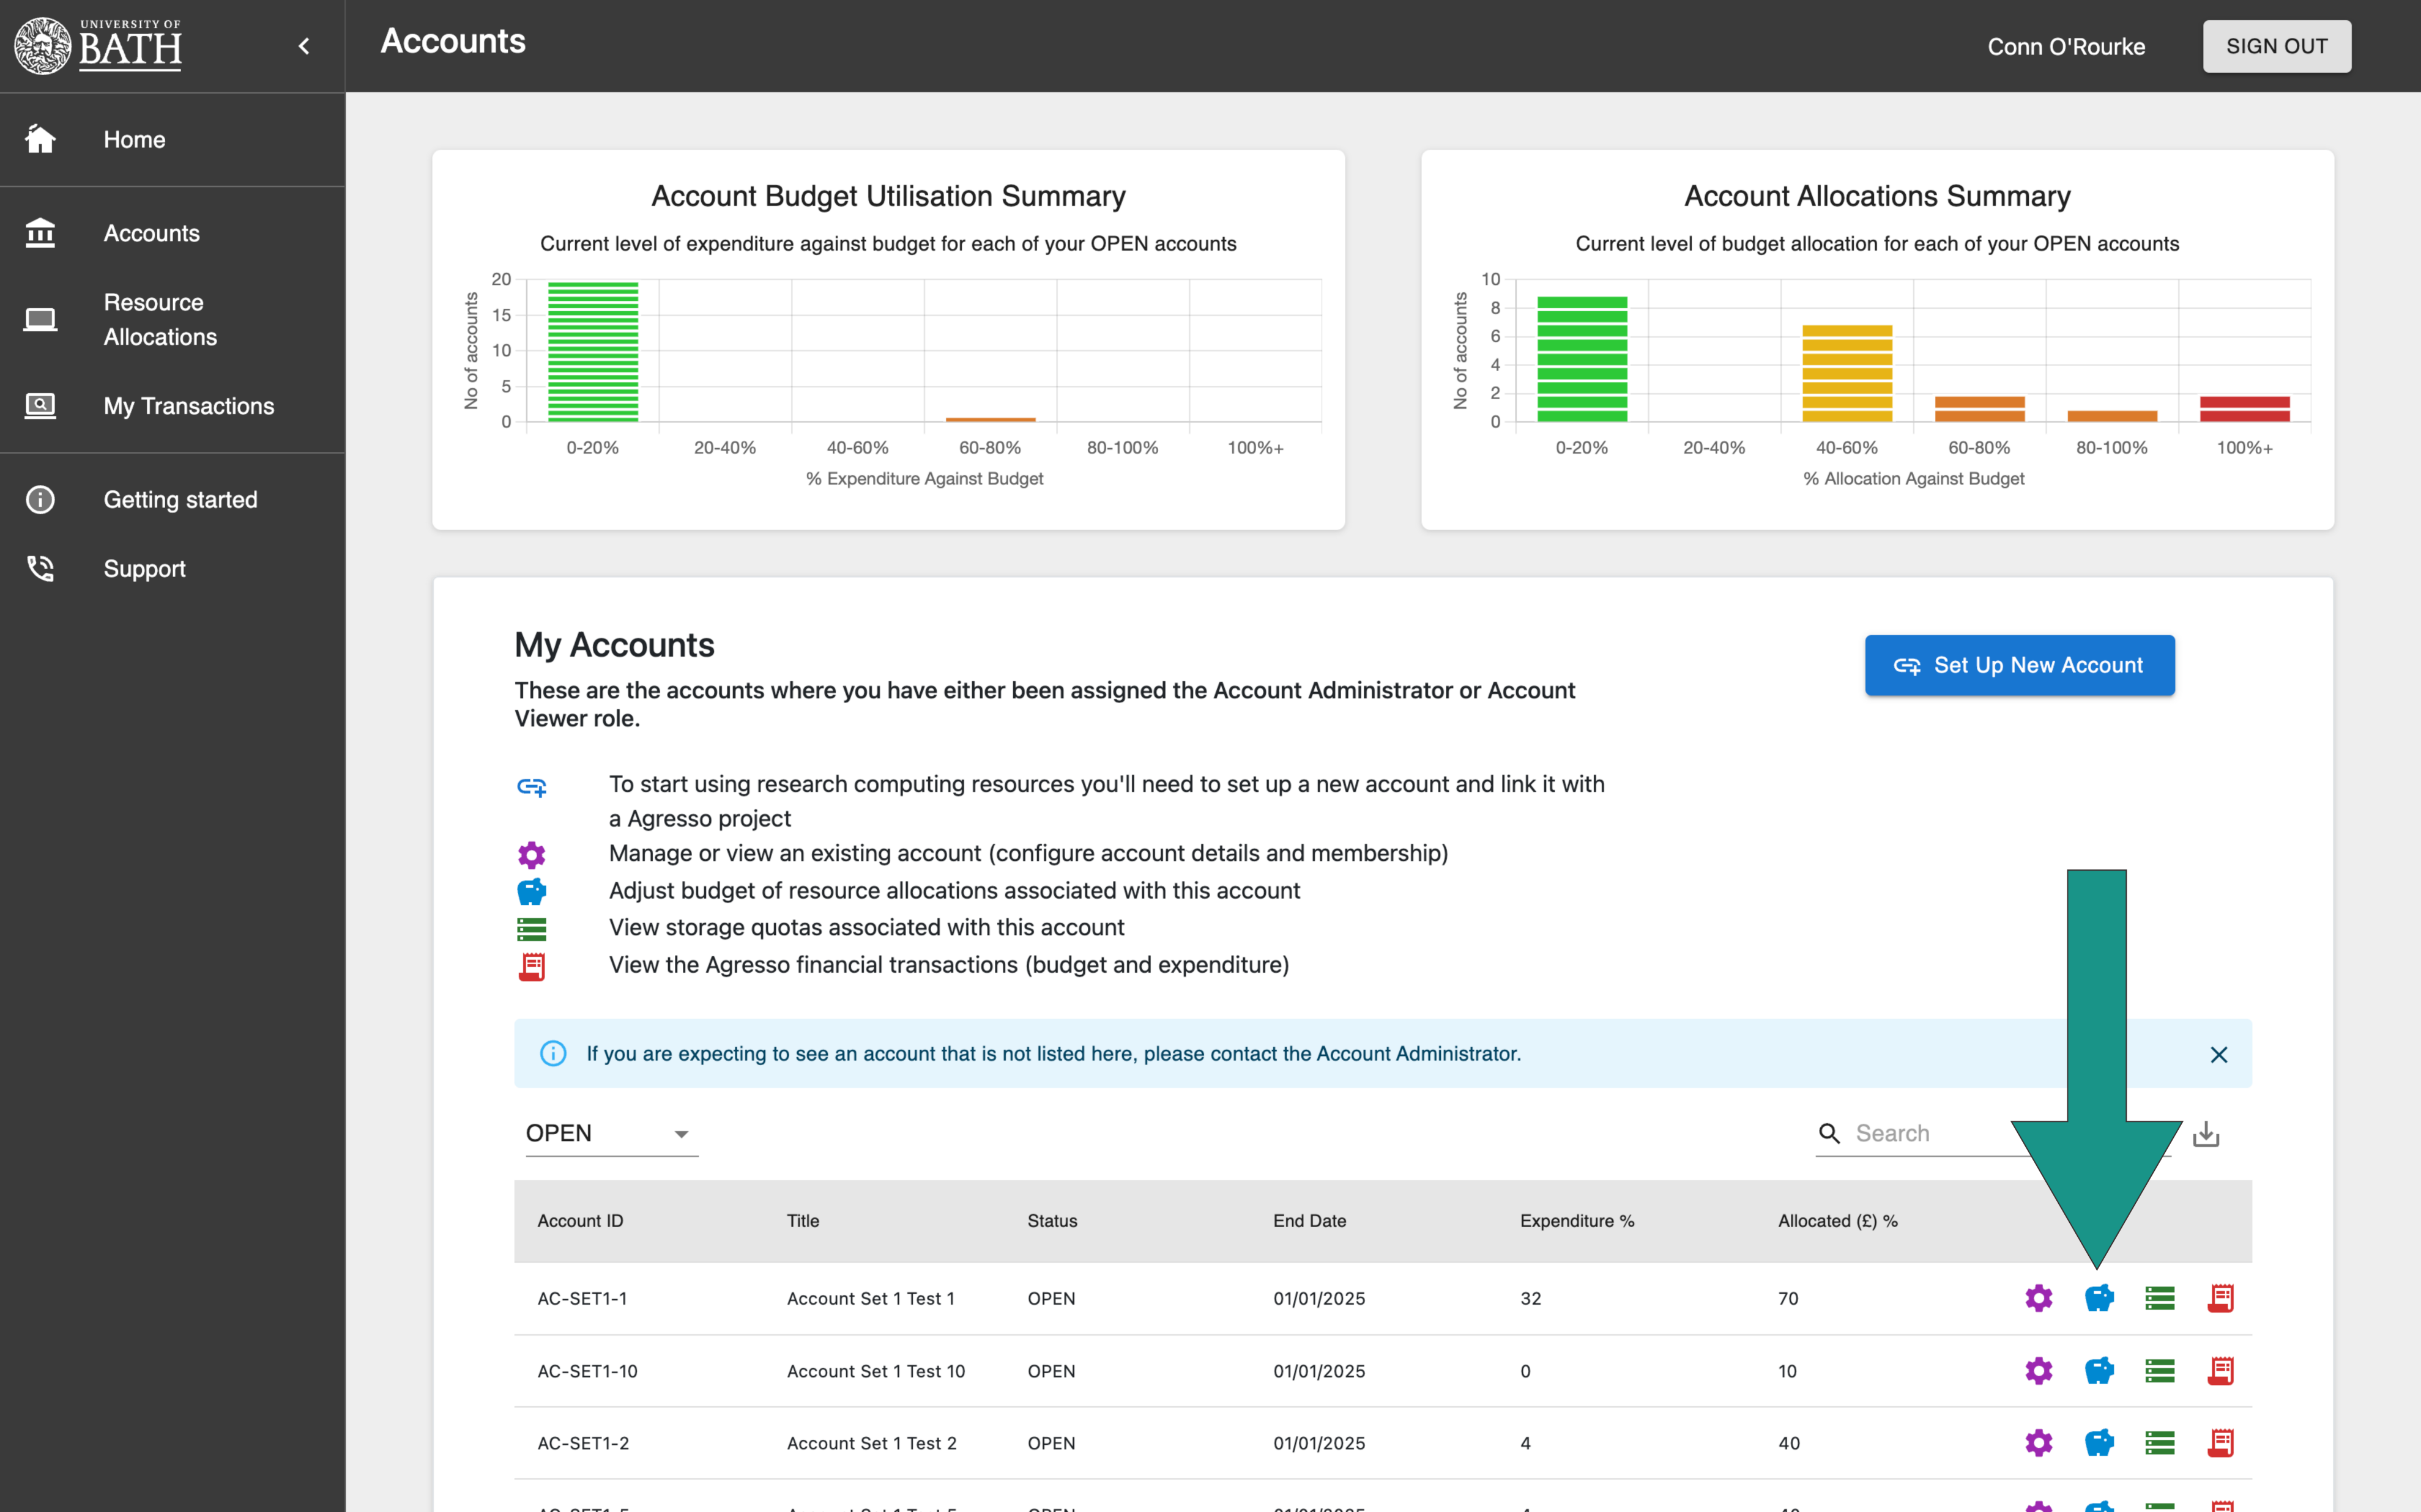
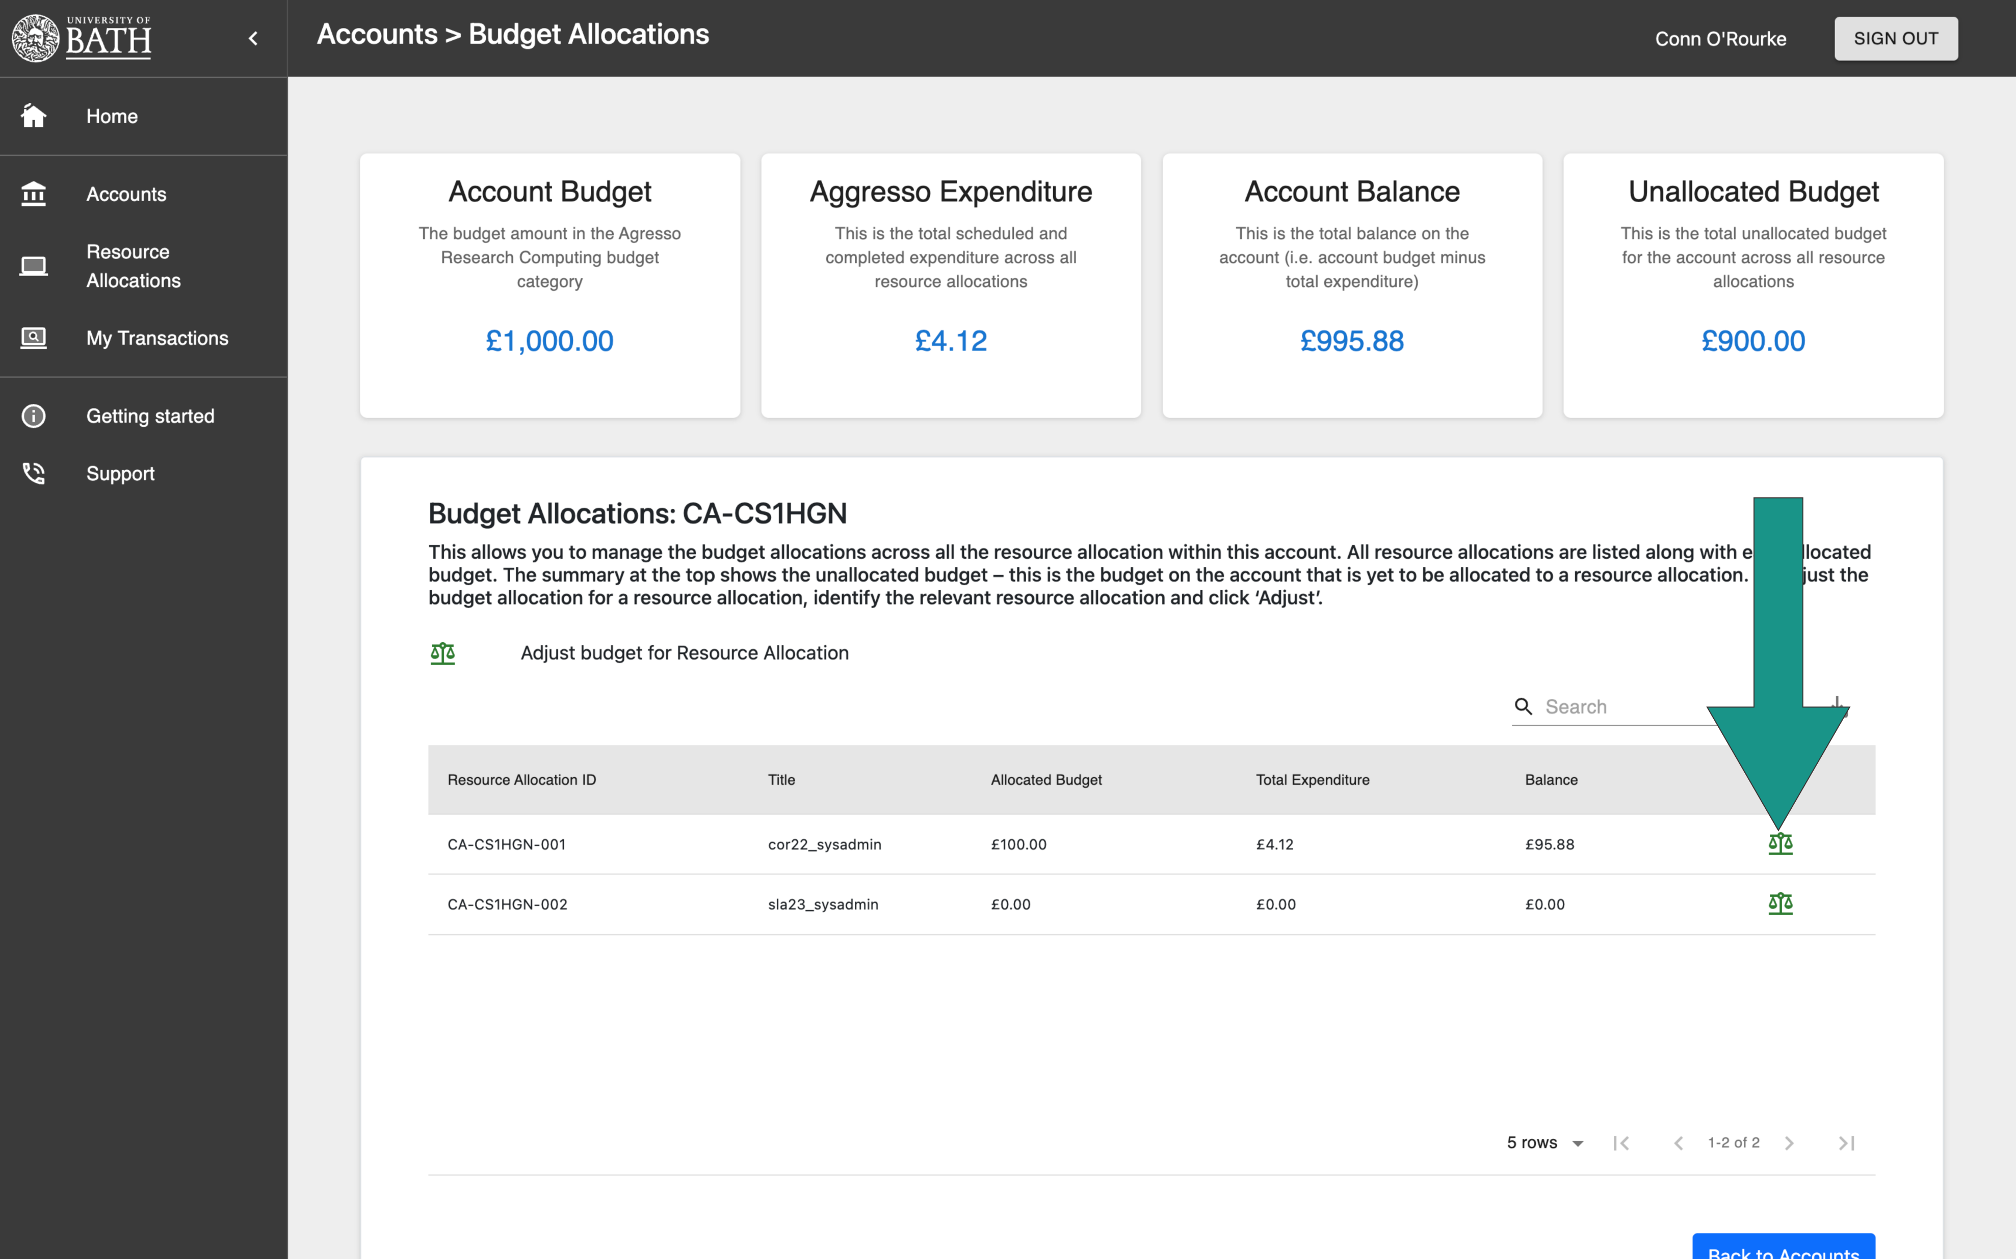
Checking funds associated with accounts

Slide 27
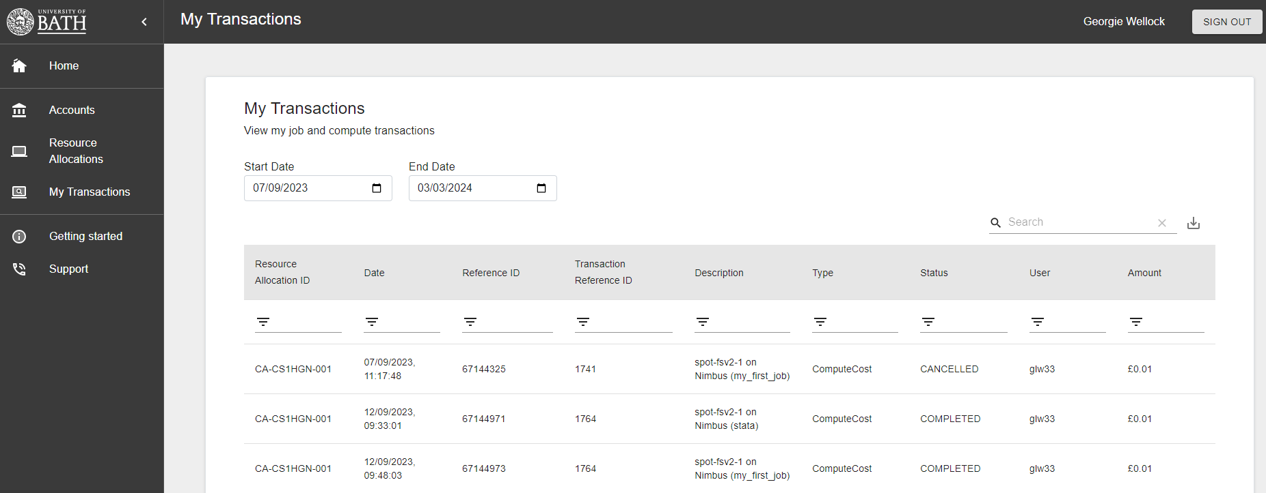
Checking transactions
Refunds on evicted or incomplete jobs will take 24 hours to be credited to accounts

Slide 28
Q&A Get Support SUBMIT A TICKET: https://bath.topdesk.net/tas/public/ssp/content/serviceflow?unid=10effda869b44d45961dd1ce975bf82c email: rc-support@bath.ac.uk SUBSCRIBE TO MAILING LIST https://forms.office.com/e/rf8rlwbaka

Slide 29
What to do next
Online training material:
https://www.bath.ac.uk/corporate-information/training-material-and-courses.bho/
Introduction to nimbus
Introduction to the Account Management Portal
In-person training by Research Computing Team (coming soon)
Request access
https://people.bath.ac.uk/em459/samba_hpc/samba_hpc_access.html £350 for SAMBa (aligned students) + more if required
https://forms.gle/Hi4DFJW66VzV6BVz7 £70 / year from departmental budget + more if required
MA40177 (Scientific Computing) in S2
Talk to me if you are interested in HPC related research

